Slide 1
Team *|∅:
The Musical
Starring
Cody “Codigail” Doyle, Anthony “Tondiggidy” Simonutti, Tong “T0ng” Liu, Chris Weir

Slide 2
Problem/Motive
-Much of the software commercially available in the financial sector leaves much to be desired.
-We aim to provide a modern product which can be easily extended by the customer.

Slide 3
Proposed Solution
Network-based modular application
Central application that connects other applications using a well defined protocol
Each application has a specific purpose in the overall application

Slide 4
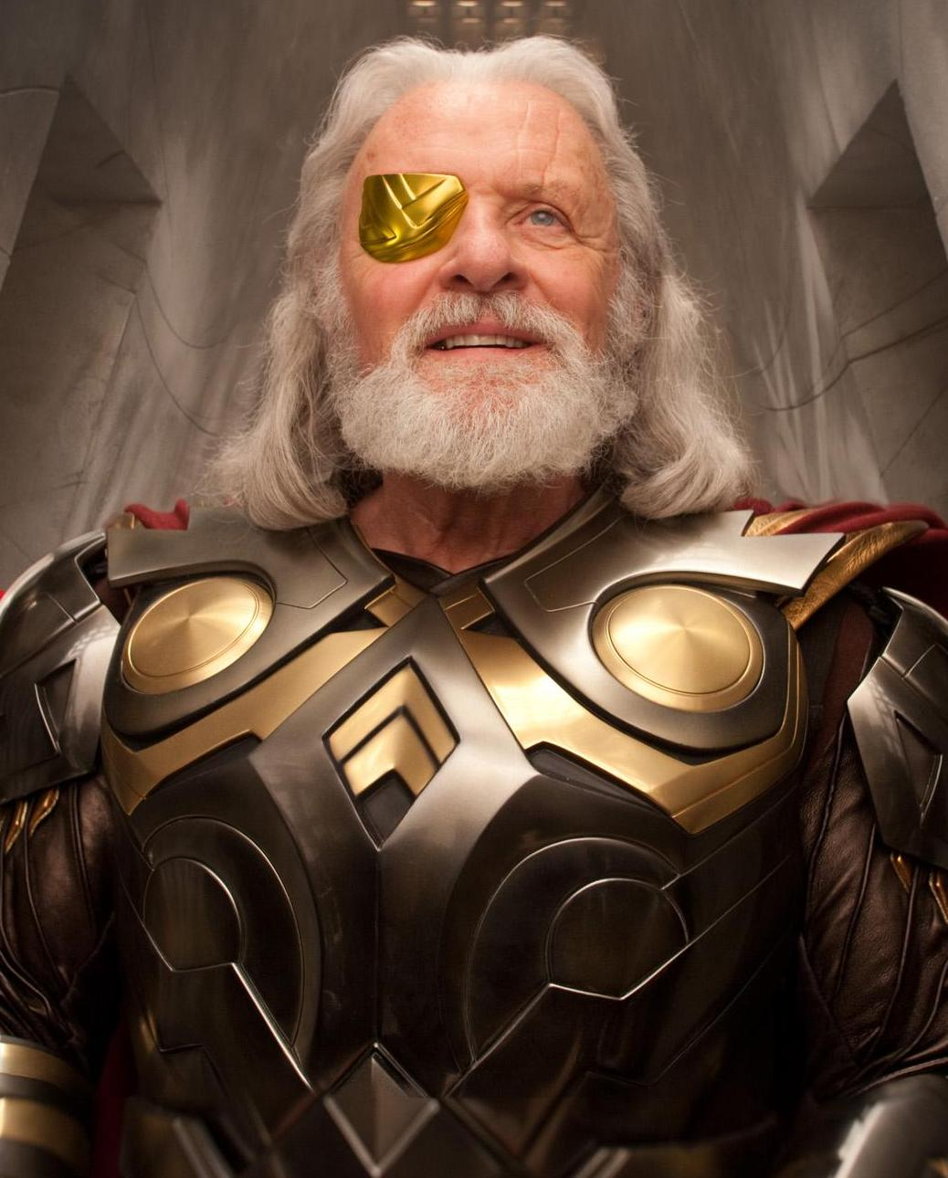
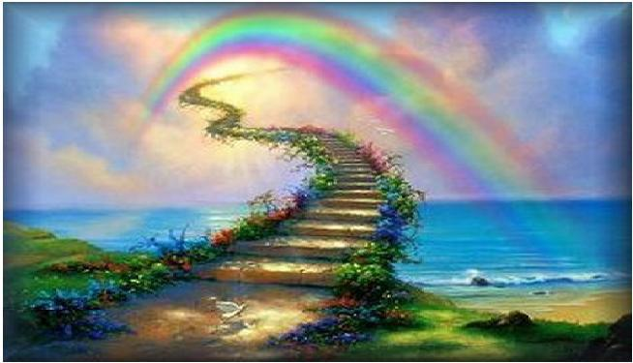

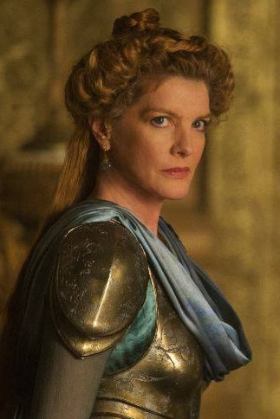
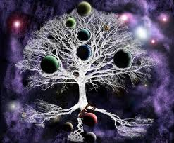
The Plugins
<Odin- Web interface
Bifrost- Feed handler>
<Frigg- Database handler
Yggdrasil- Intermediary>
Notes:
cody

Slide 5
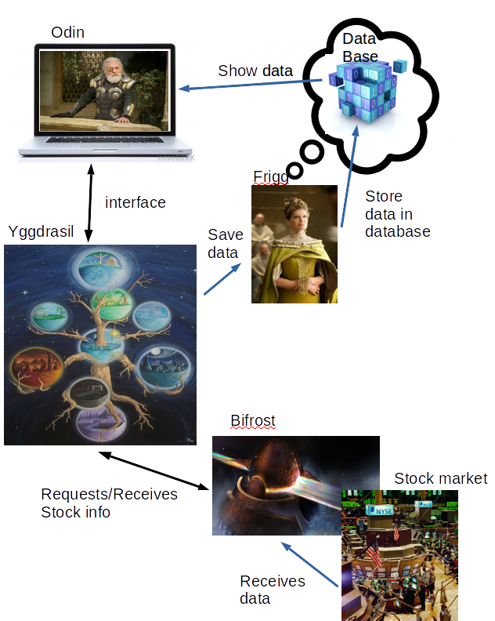
Proposed Solution (cont.)
Plugin!
Notes:
cody

Slide 6
Demo
All about dat Demo
Notes:
GOD DAMN IT TONY

Slide 7
Advantages of New Design
Programmer friendly
Easy to add new custom modules
Easy to adjust yggdrasil itself
Notes:
Codigail

Slide 8
Disadvantages of New Design
Non-instantaneous feedback (15 second delay)
Takes some time to initialize each plugin
Custom modules could result in unexpected behavior
Notes:
tong

Slide 9
Overall Experience
Learned value of planning and OO programming
Individually learned new skills along the way
Came up with a cool product we are proud of
Notes:
Codigail

Slide 10
What went well
Agile development habits, Scrum meetings
We actually finished (Woo)
Prototyping before development
Notes:
T0ng

Slide 11
What went less well
Uneven work distribution (Web UI)
Meeting deadlines early
Notes:
TOOOOOOOOOOOOOOOOOOOOOOOOOOOOOOOOOOOOOOOONDIGGIDY

Slide 12
Communication Methods
SVN for version control (hosted by google code)
Trello for task organization in the beginning
Google groups for email communication
Full weekly meetings on Saturdays

Slide 13
Future of the Project
Applying a Yggdrasil like structure to other applications
Might add some good analytical tools (plugins)
Notes:
Chris + everyone

Slide 14
TEAM *|∅
“GOOD ENOUGH’’

